Slide 1
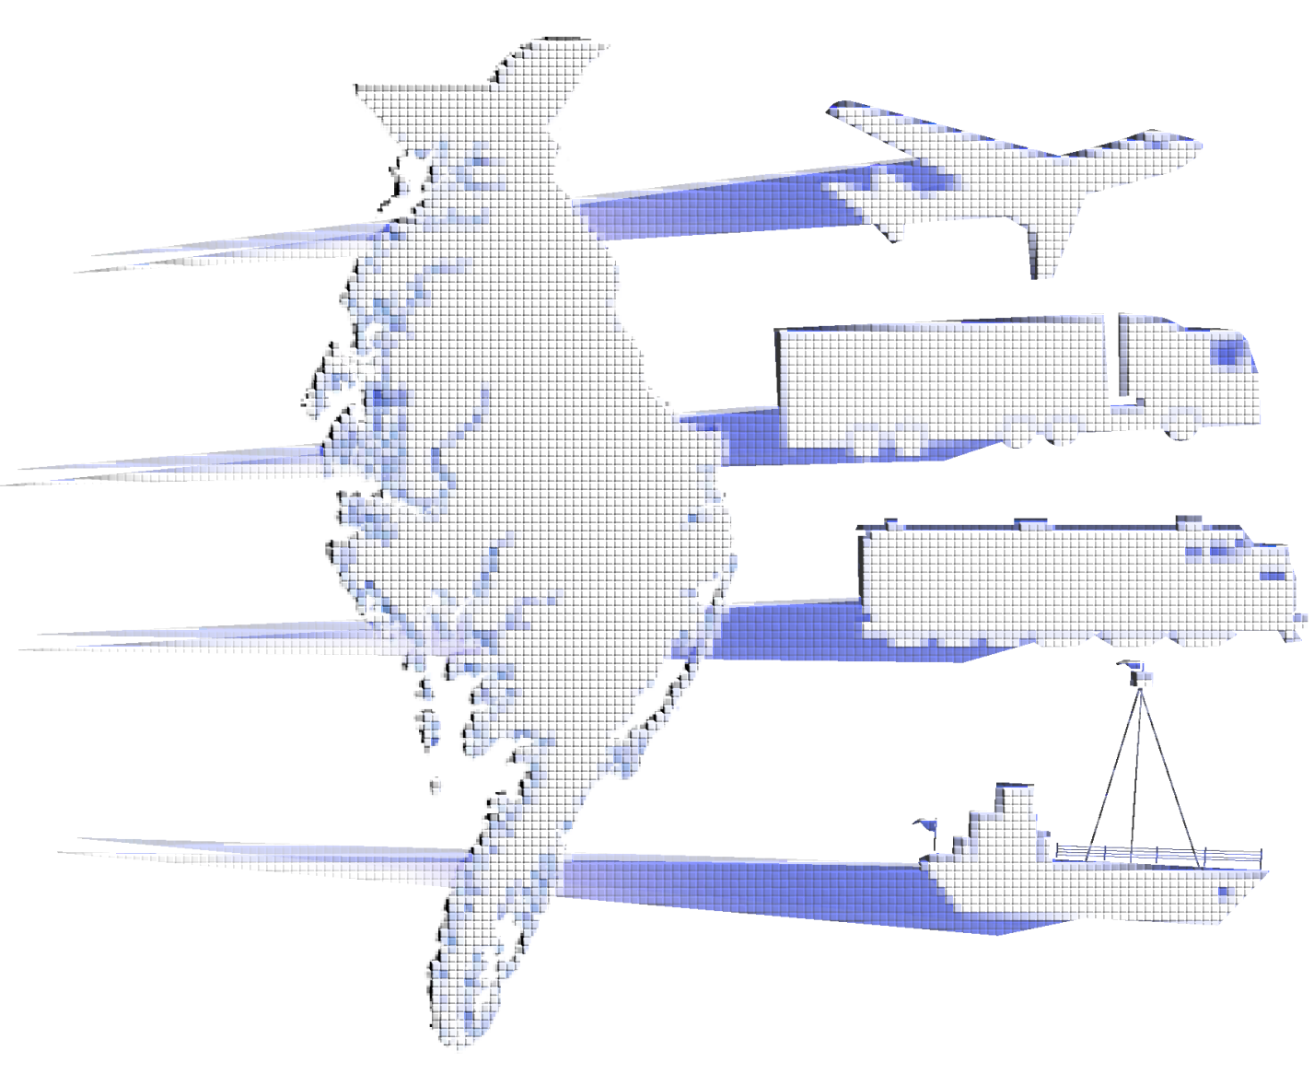
Delmarva Freight Study
May 8, 2013
Central Delaware Chamber of Commerce
Transportation Committee

Slide 2
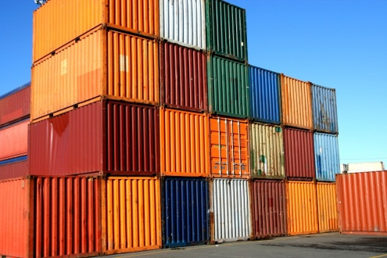
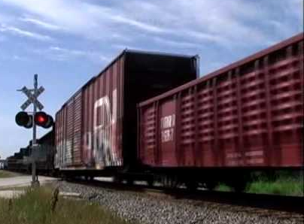
Agenda
What is the Delmarva Freight Study? - Moving Ahead for Progress in the 21st Century
MAP-21
2. Efforts to date - Economic/Industry Factors - Data Collection - Development of CUBE Cargo
3. Possible Scenarios/Document Development
4. Next Steps

Slide 3
What is the Delmarva Freight Study?
A multi-state, multi-MPO effort to develop a comprehensive, multi-modal evaluation of the freight transportation system and its operations along the Delmarva Peninsula.
According to MAP-21, States are highly recommended to have a freight plan which can improve their ability to meet National Freight Policy goals & objectives.
Not a requirement, but in order for some projects to be eligible for fed $, they must come from a freight plan!

Slide 4
Key Functions of Study
Collect Most Recent Commodity Flow Data: - Transearch, FAF2, FAF3,
- Surface Transportation Board Waybill
Conduct Outreach (Agencies, Industries & Shippers)
Develop CUBE Cargo Model
Generate Current/Future Freight Forecasts for Multiple Modes (Truck, Rail, Water, Pipeline)
Analyze Future Freight Planning Scenarios

Slide 5
ECONOMIC/ INDUSTRY FACTORS
Freight traffic in Delmarva region is highly concentrated.
Five commodity groups constitute over 70% of the region’s truck traffic.

Slide 6
ECONOMIC/ INDUSTRY FACTORS
Demographic Data Analysis
Commodity Flow & Households
Growth in Households will Drive Internal Peninsula Shipments of Secondary Traffic to Meet the Demand of Consumers.
Employment in the Top 4 Freight Related Industries is over 1/3 Total Employment,
Half of which is in Trade, Transportation & Utilities.

Slide 7
Industrial Outlook
U.S. Spends Only 1.7% of its GDP on Transportation Infrastructure while Canada Spends 4% & China Spends 9% . (Source: KC Smartport Supply Chain Centered)
Infrastructure Deficiency Decreases Productivity Per Worker, Critical Job Opportunities are Lost in Highly Skilled & Well-Compensated Non-Transportation Sectors Throughout the Economy. (Source; Report by American Society of Civil Engineers, 2011)
Implications for Delmarva: With the Major Congestion Issues, Residential Encroachment, the Need for Improved Motor Freight, Barge & Potential Rail Service is Critical, there is a Strong need to Address the Infrastructure Deficiencies & Provide Support / Improvement Where Possible.
Peak Seasonal Traffic Coincides with the Need for Motor Freight Traffic to Serve Peak Seasonal Population, Creates Additional Congestion Issues Related to Freight Movement, Economic Stability & Quality of Life.

Slide 8
Data Collection Transearch (IHS Global Insight) FAF 2, FAF 3 STB Waybill (Rail)

Slide 9
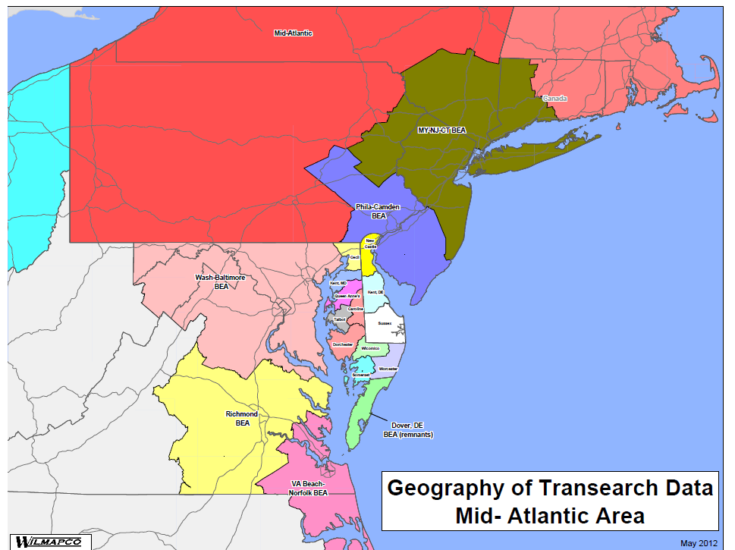
Transearch (IHS Global Insight)

Slide 10
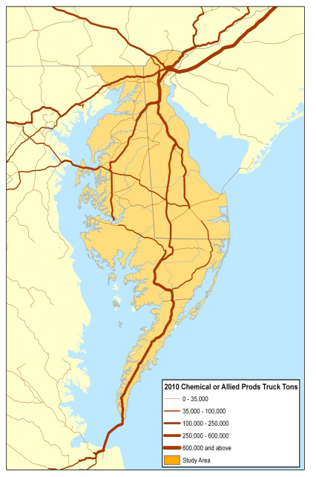
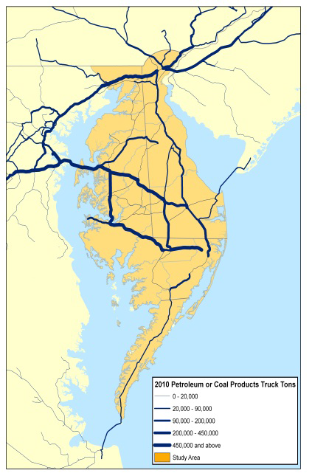
Delmarva’s Major Industries Have Different Freight Flow Characteristics:
Food
Petroleum

Slide 11
Analysis and Stakeholder Research

Slide 12
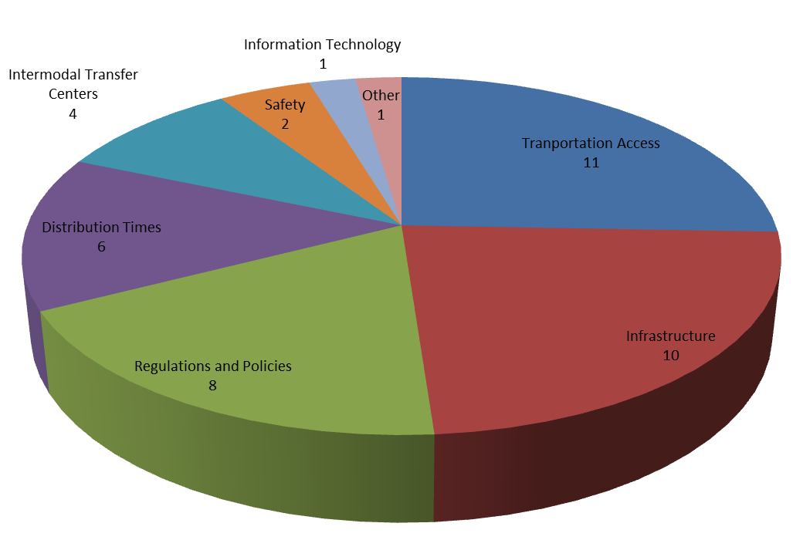
Status Updates
Stakeholder Outreach
Online Survey: Specific Problems / Areas of Concern

Slide 13
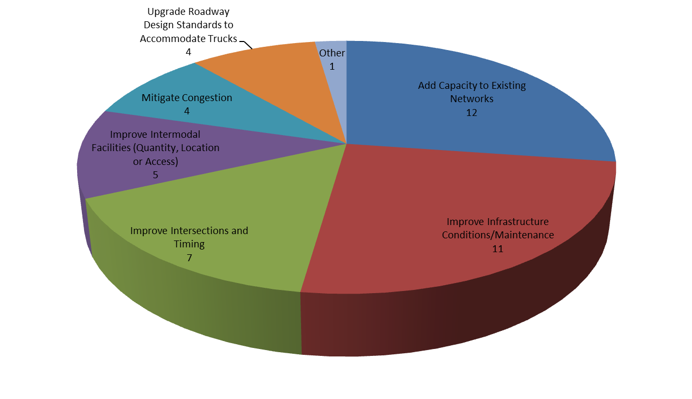
Status Updates
Stakeholder Outreach
Online Survey: Key Infrastructure Related Improvements

Slide 14
Status Updates
Stakeholder Outreach
Online Survey: General Comments
36% Miscellaneous Infrastructure Improvements
25% Truck Restrictions (height, weight, width, hazmat)
17% Northeast Corridor Constraints
11% Rail Restrictions (height, weight, width)
11% Short Line Railroad Support

Slide 15
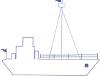
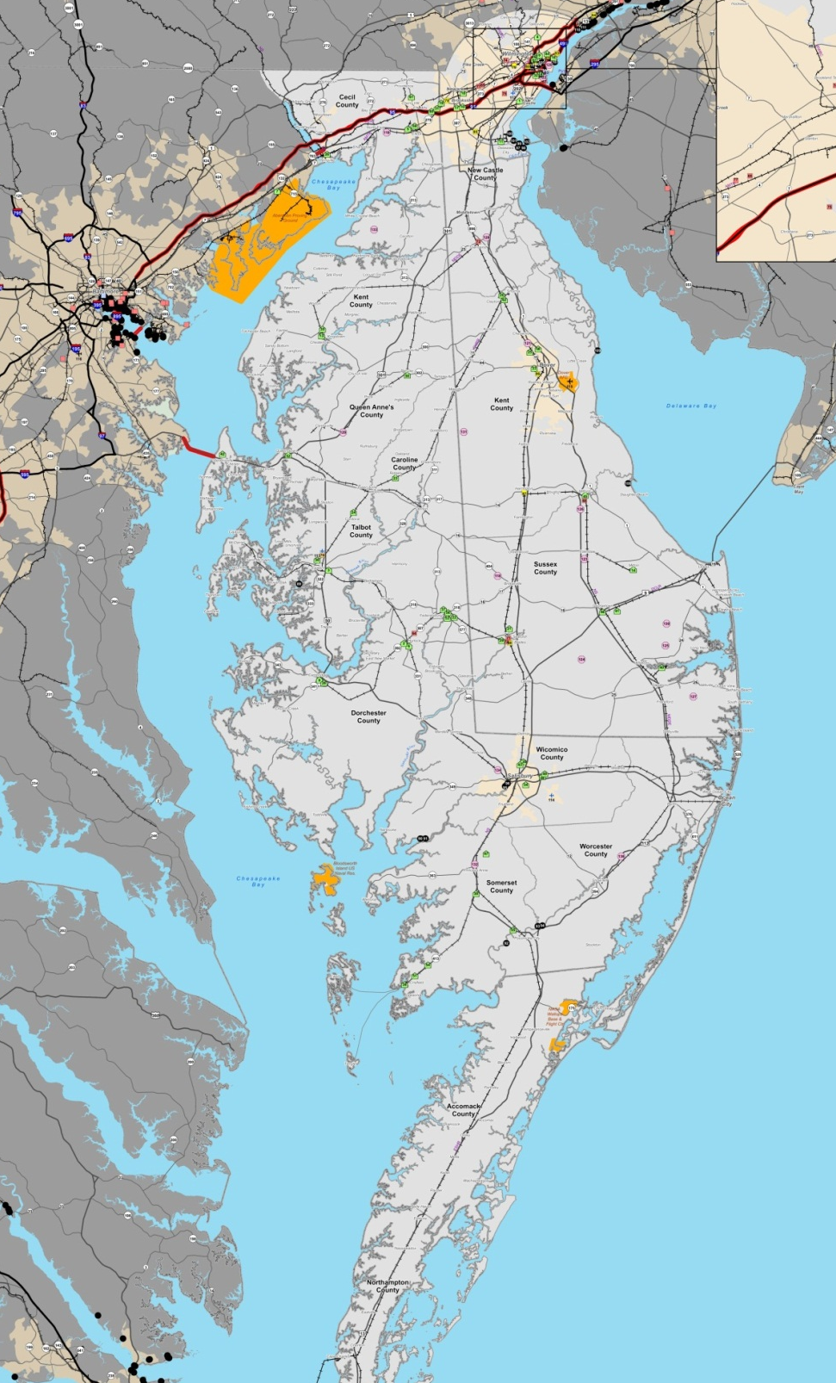
Areas of Concern (from Outreach):
NEC
PA or …
Wilmington
Rail
NEC / Chesapeake Connector
Delmarva Secondary / Indian River Coal
75 Rail Car Capacity
Cape Charles Rail Car Float
Ports
Post-Panamax
New Markets
Inland Waterways
Nanticoke & Wicomico Rivers
Spoil Sites for Dredged Materials
Motor Freight
Seasonal / Tourist-Based Congestion
Secondary Roads / Bridges
Fuel Taxes / Toll Rates / Weight Limits
Parking & Rest Areas
Air Freight
Delmarva
Secondary
Baltimore
Indian River
Coal Plant
Nanticoke
Wicomico
VA or …
Cape Charles
Rail Car Float

Slide 16
New Castle
County
Areas of Opportunity (from Outreach):
Cecil
County
Fracking
Growth & Industry
Cecil County
New Castle County
Sussex County
Wicomico County
DAFB Civil Air Terminal
Site-Specific Issues
PBF Energy Rail Expansion
Dogfish Head Brewery Expansion
Seaford Multimodal Connectivity
Salisbury Multimodal Connectivity
NASA Wallops Flight Facility
Import-Export
Fracking Materials to Marcellus Shale
Crude Oil from Canada or Midwest
Grain from Midwest
Frozen Poultry to Russia
Enterprise Zones / Other Incentives
Crude Oil
PBF Energy
Dogfish Head
Brewery
Sussex
County


Seaford
Salisbury
Wicomico
County





Petroleum
Grain


NASA

Poultry

Slide 17
Scenario Development

Slide 18
Scenario Planning
Performance Based Approach
Include performance measures to guide freight-related transportation decisions
Retain consistency w/ the National Freight Strategic Plan
Tie each measure to each goal to indicate how well the system is achieving that goal
Reflect measures of conditions of infrastructure and of service performance
Reflect outcomes that are directly important to system users and the general public
Avoid measures that are not of direct importance to users or the general public

Slide 19
Scenario Planning
Economic Evaluation
Qualitative screening relative to scenario-specific issues
Review of low-medium-high levels of impact
Review of global factors or unknowns vs. potential for “missed” opportunities
Address industry-specific impacts of changes in:
Freight costs, availability, reliability, and time
Related impacts on jobs and payrolls
Secondary / multiplier effects on jobs and payrolls
Secondary / multiplier effects on fiscal and tax impacts
Add’l research: cost of goods movement as a % of overall costs
Add’l research: industry-specific elasticities (e.g., tourist impact vs. congestion)

Slide 20
Scenario Planning
Cube Cargo Evaluation
Potential Measures of Effectiveness include:
Travel Time to Market by Mode
Level of Service
Delay
Transportation Cost by commodity and mode
Emissions
Truck Volumes on Roadways
Freight Demand by Mode
Add’l research: Cost assumptions for freight movement by mode

Slide 21
NEC
Potential Scenarios: Two Types
Crude Oil
PBF Energy
POLICIES
&
PROJECTS
Delmarva
Secondary
Dogfish Head
Brewery
Indian River
Coal Plant
Factors to React to . . .
Rail Service Loss
Port Expansion or Market Shifts
Post-Panamax Impacts
Inland Waterway Loss
Truck Transportation Costs
Energy Market Trends (Coal, Oil)
Fulfillment Services Trends
Factors to Influence . . .
Rail Service Efficiencies
Intermodal Infrastructure
Port Access Enhancements
Infrastructure Preservation
Truck Transportation Policies
Freight Network Connectivity
Land Use Preservation
Petroleum
Grain
NASA
Cape Charles
Rail Car Float
Poultry

Slide 22
Next Steps
PART 1
PART 2
TASK 1
Outreach &
Data Collection
Document
Review
Data
Collection
TASK 2
Projections &
Analyses
Trade
Characteristics
Federal Planning
Factors
TASK 3
Planning Scenarios
& Sensitivity Analysis
TASK 4
Results &
Recommendations
Outreach
Goals &
Objectives
Cargo
Model
Freight Programs
& Coordination
Performance
Measures
Capital Plans
& Programs
Future
Planning
Scenario
Planning
Policy
Plan
Funding
Options
Transportation
Plan
Economic
Plan
Impact
Evaluations
Strategy
Options

Slide 23
Other Steps
Establish Regional Advisory Group
MAP 21 (Section 1117): Establish a state freight advisory committee consisting of a representative cross-section of public and private sector freight stakeholders, including representatives of ports, shippers, carriers, freight-related associations, the freight industry workforce, the transportation department of the state, and local governments.
Advise the State on freight-related priorities, issues, projects, and funding needs;
Serve as a forum for discussion of State decisions affecting freight transportation;
Communicate and coordinate regional priorities with other organizations;
Promote the sharing of information between the private and public sectors on freight issues
Participate in the development of the State’s Freight Plan and it’s implementation.

Slide 24
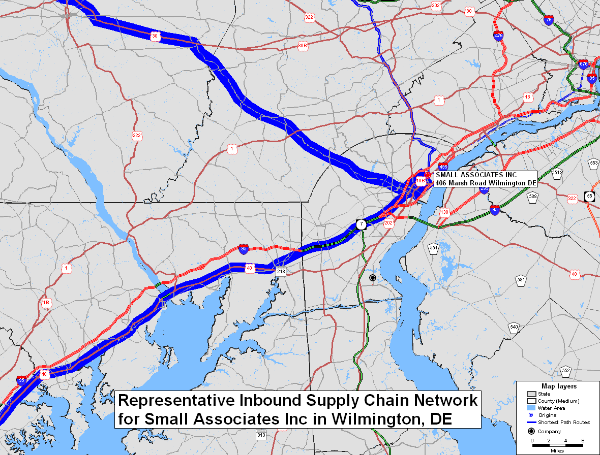
Other Steps
Delaware Chemical Supply Chain Analysis
Produce detailed supply flows into Delaware’s chemical supply chains and emerging chemical industry market trends or logistics practices to identify potential opportunities for economic development or changes in the State’s freight system that could strengthen supply chain performance.
Status: Pending approval from WILMAPCO Council in May
Potential Supply Chain Analyses
Agriculture / Poultry
Secondary Traffic
Export-Related Locations
Others !

Slide 25
Questions???

