Slide 1
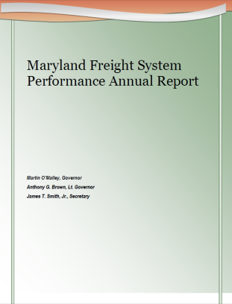
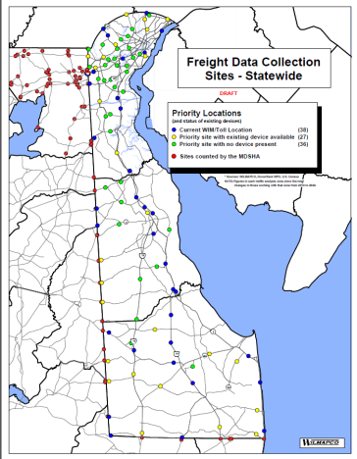
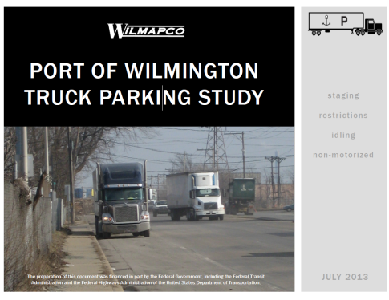
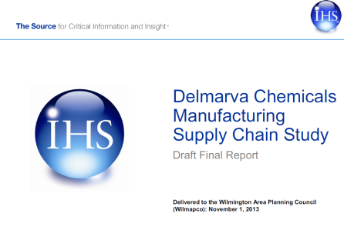
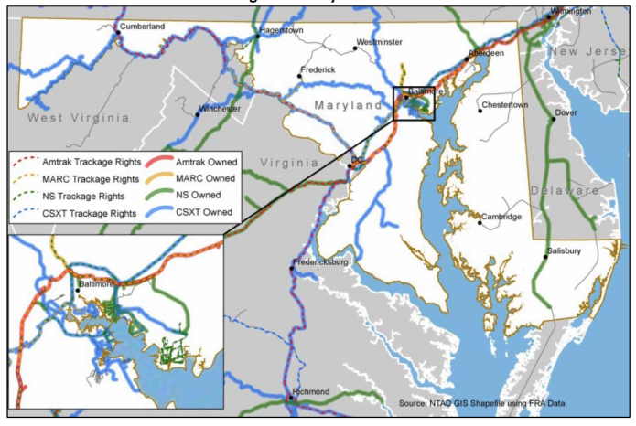
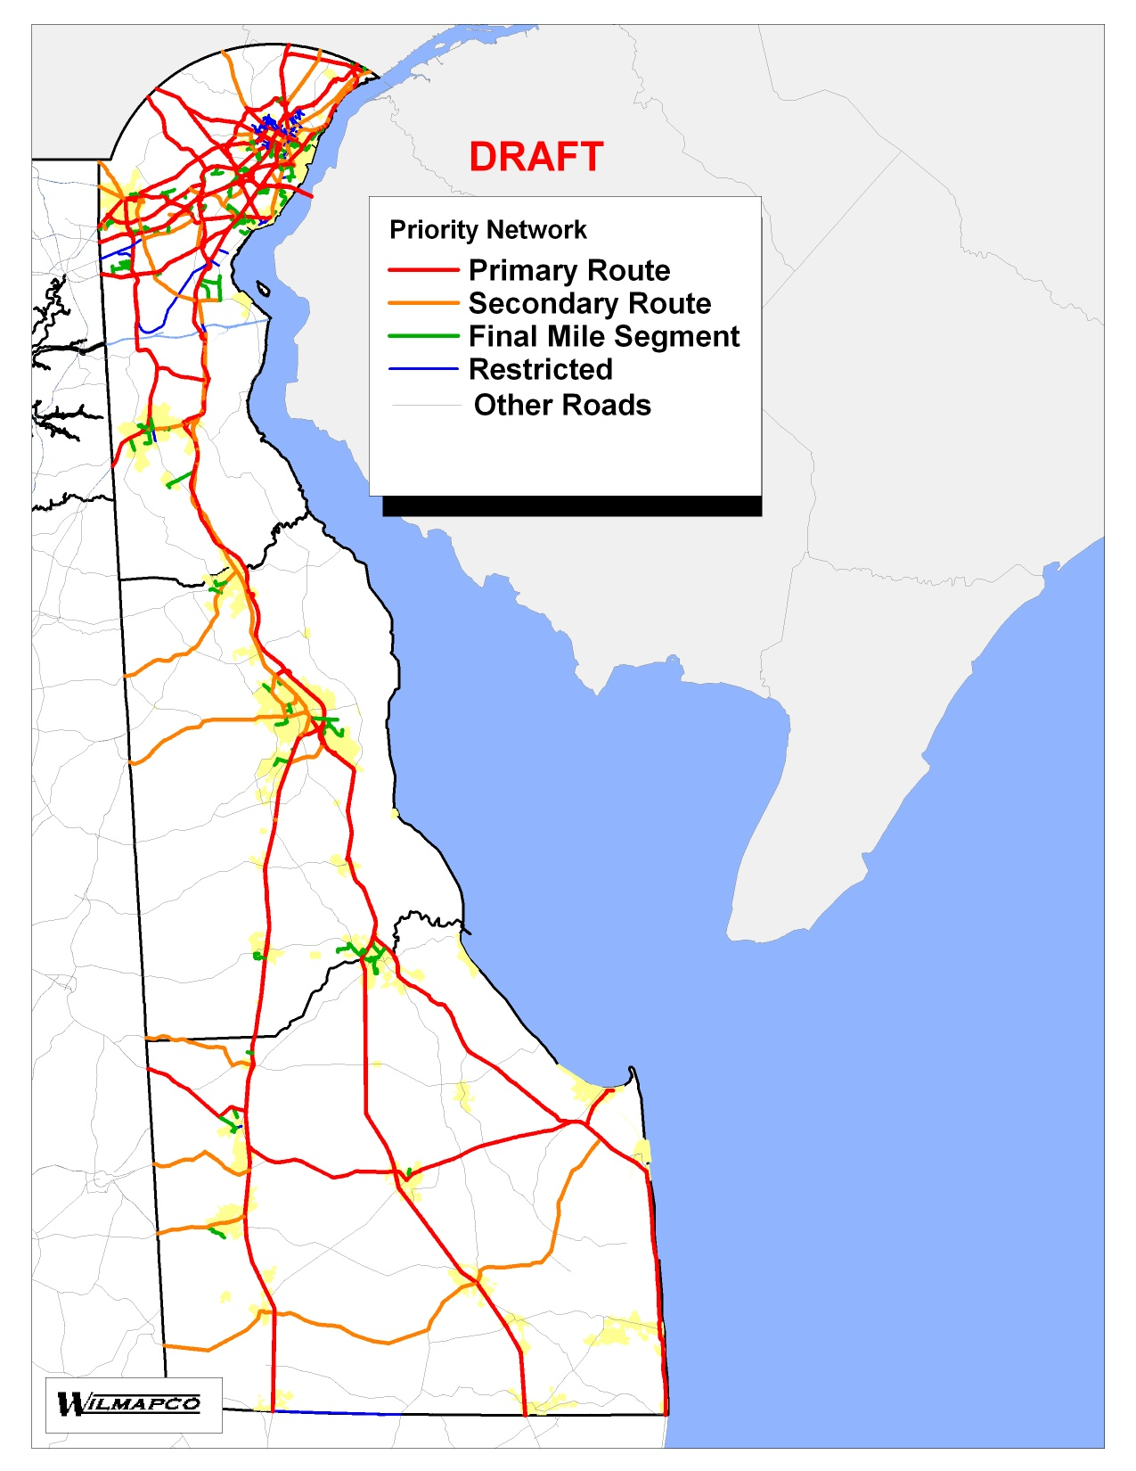
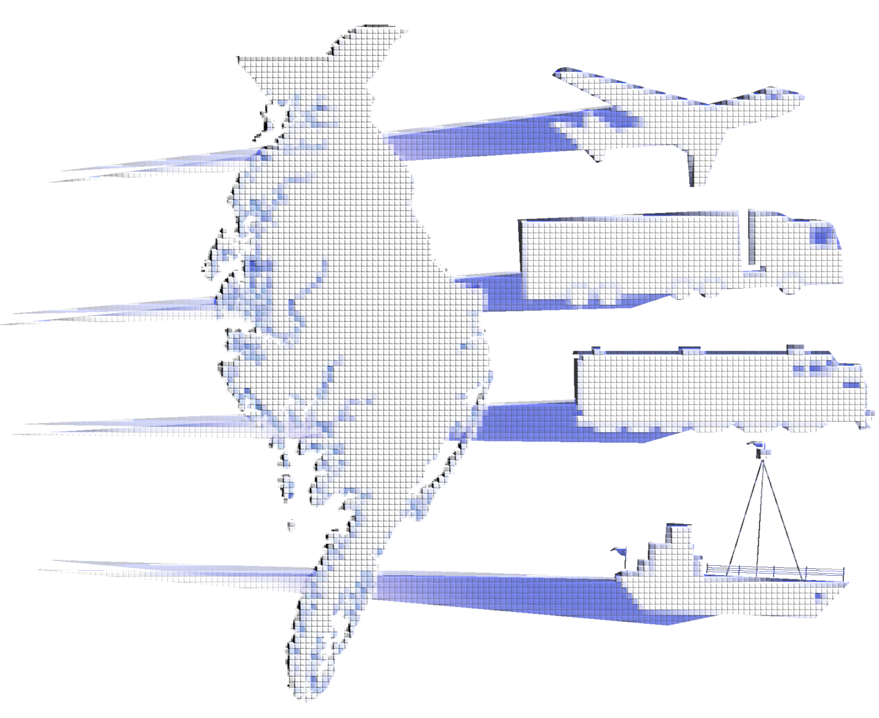
Freight Activities:
Year in Review
Dec. 12th 2015

Slide 2
Where have we been?
2009 & 2010: Delmarva Rail Summit
2011-Present: Expanded to include all freight. Over 200 unique
attendees to summit
2013 – Present: Added “Winter Meetings”
2014 Established Delmarva Freight & Goods Movement
Working Group
Includes:
- Public Agencies (DOTs, MPOs)
- Private Sector
- Ports
- Anyone interested in freight!

Slide 3
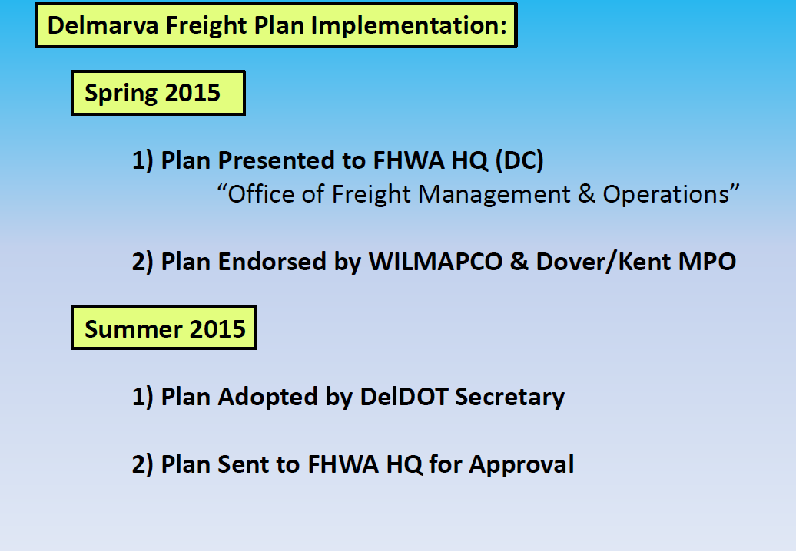

Slide 4
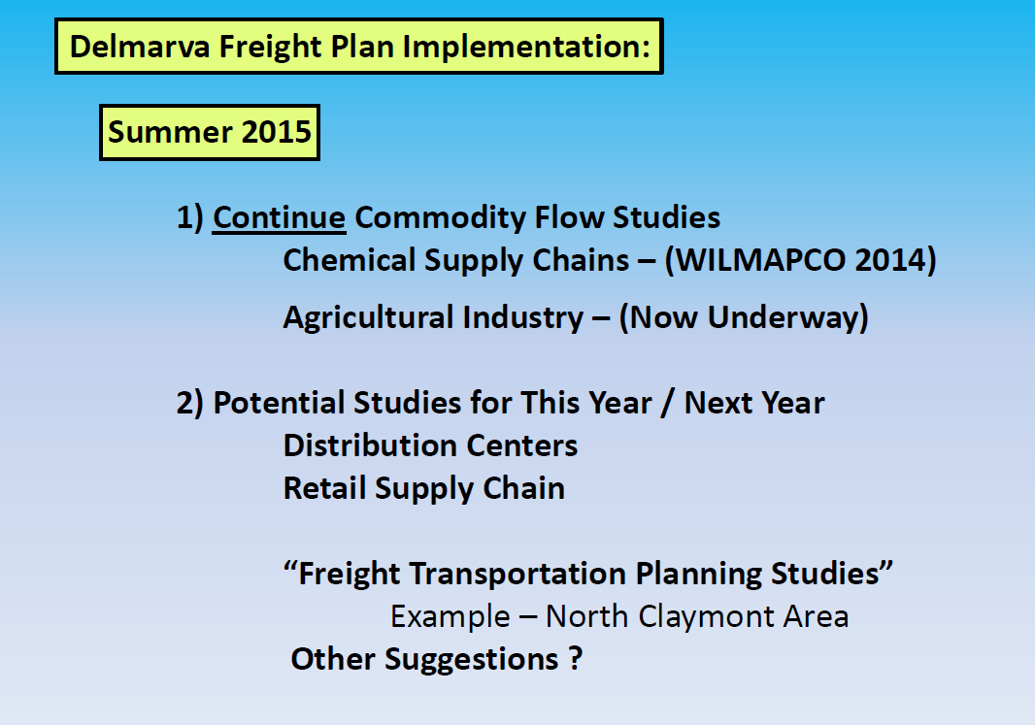

Slide 5
Projects, Studies and Initiatives
from Last Year

Slide 6
Beyond the Freight Plan…….
Freight System Performance Monitoring
Pavement condition on the Interstate System and on remainder of the National Highway System (NHS)
Performance of the Interstate System and the remainder of the NHS
Bridge condition on the NHS
Fatalities and serious injuries – both number and rate per vehicle mile traveled – on all public roads
Traffic congestion
On-road mobile source emissions
Freight movement on the Interstate System

Slide 7
Beyond the Freight Plan…….
Strategic Implementation Actions
Encourage the State Freight Advisory Committee
Finalize performance measures
Set initial performance targets
Prepare for performance reporting
Refine future performance monitoring details
Track future implementation details
Enhance integration within statewide planning processes
Inform future funding and implementation decisions

Slide 8

Beyond the Freight Plan…….
Strategic Implementation Actions
Encourage the State Freight Advisory Committee
Finalize performance measures
Set initial performance targets
Pending
US DOT
Prepare for performance reporting
Refine future performance monitoring details
Track future implementation details
Enhance integration within statewide planning processes
Inform future funding and implementation decisions

Slide 9
Beyond the Freight Plan…….
Future Plan Enhancement Options
Maintain future commodity flow data
Maintain the Cube Cargo model
Investigate additional freight planning scenarios
Study key supply chains
Study potential expansion of CVISN’s VWS coverage
Integrate dashboard summaries
Evaluate strategies for compiling multistate crash data
Develop a mapping and data platform to summarize Delmarva’s freight environment

Slide 10
Beyond the Freight Plan…….
Future Plan Enhancement Options
Maintain future commodity flow data
Maintain the Cube Cargo model
Investigate additional freight planning scenarios
Study key supply chains
Study potential expansion of CVISN’s VWS coverage
Integrate dashboard summaries
Evaluate strategies for compiling multistate crash data
Develop a mapping and data platform to summarize Delmarva’s freight environment

Slide 12
New Federal Legislation

Slide 13
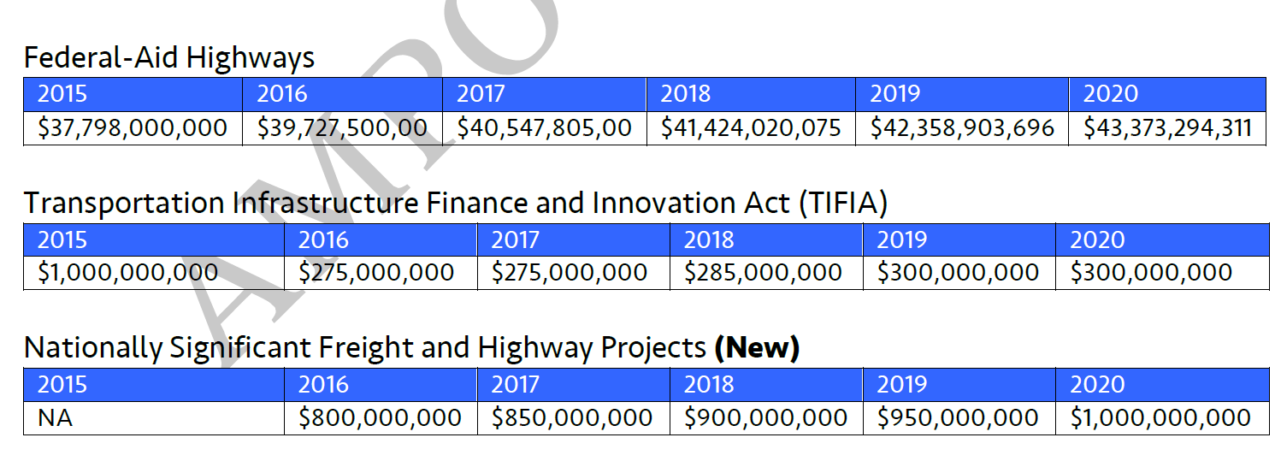
Fixing America’s Surface Transportation (FAST) Act
Freight Benefits

Slide 14
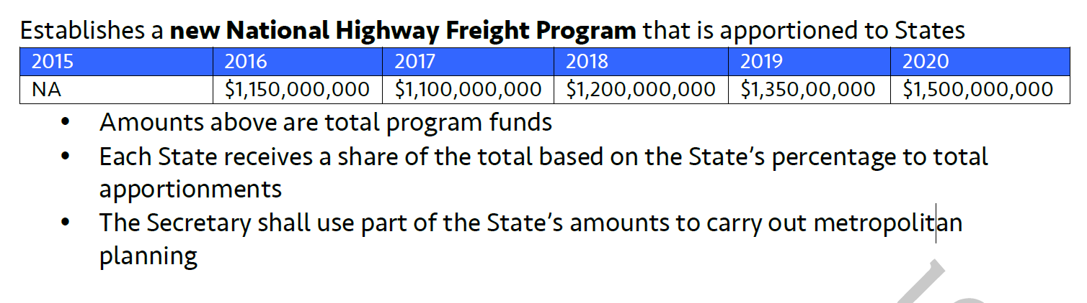
Fixing America’s Surface Transportation (FAST) Act
Freight Benefits

Slide 15
Fixing America’s Surface Transportation (FAST) Act
Freight Benefits
Sec. 1116 National Highway Freight Program (NEW) New Section 167 in title 23 of the US Code
• Establishes a national policy and goals
• The FHWA Administrator shall establish a National Highway Freight Network consisting of – the 41,518 mile network establish in MAP-21, critical rural freight corridors, critical urban freight corridors, and portions of the Interstate system not included in the 41,518 mile primary highway freight system
• Redesignation shall occur every 5 years but caps the increase in mileage to not more than 3% of the total system; establishes a process for redesignation
- Establishes criteria to designate critical rural and urban corridors
- MPOs in areas over 500,000 in population may designate urban corridors
in consultation with the State
- States designate urban corridors in areas under 500,000 in consultation
with MPOs
- Establishes requirements for urban designations

Slide 16
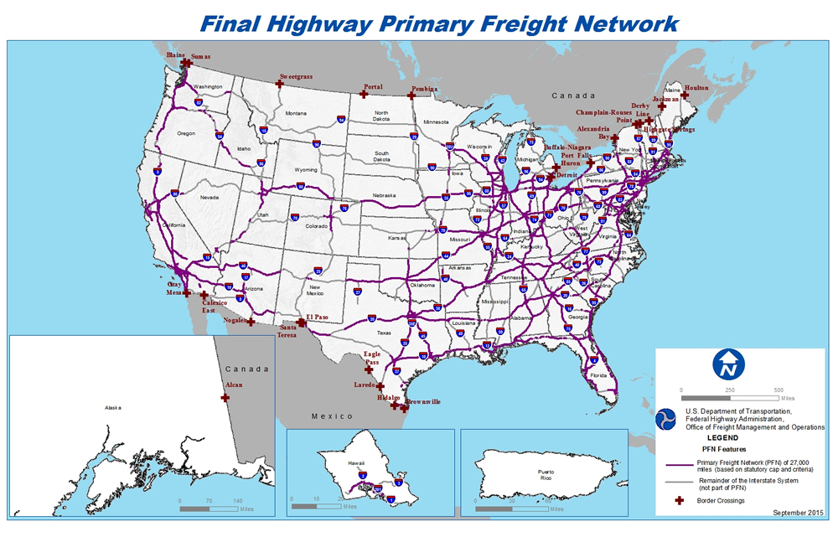
Fixing America’s Surface Transportation (FAST) Act
Freight Benefits

Slide 17
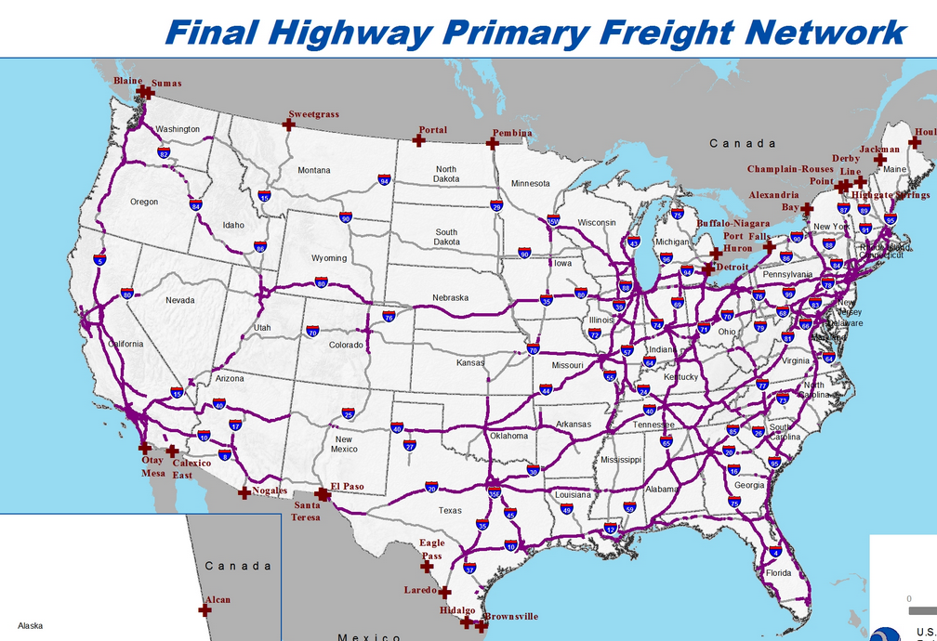
Fixing America’s Surface Transportation (FAST) Act
Freight Benefits

Slide 18
Fixing America’s Surface Transportation (FAST) Act
Freight Benefits
Sec. 1116 National Highway Freight Program (NEW) New Section 167 in title 23 of the US Code
• Establishes a national policy and goals
• The FHWA Administrator shall establish a National Highway Freight Network consisting of – the 41,518 mile network establish in MAP-21, critical rural freight corridors, critical urban freight corridors, and portions of the Interstate system not included in the 41,518 mile primary highway freight system
• Redesignation shall occur every 5 years but caps the increase in mileage to not more than 3% of the total system; establishes a process for redesignation
- Establishes criteria to designate critical rural and urban corridors
- MPOs in areas over 500,000 in population may designate urban corridors
in consultation with the State
- States designate urban corridors in areas under 500,000 in consultation
with MPOs
- Establishes requirements for urban designations

Slide 20
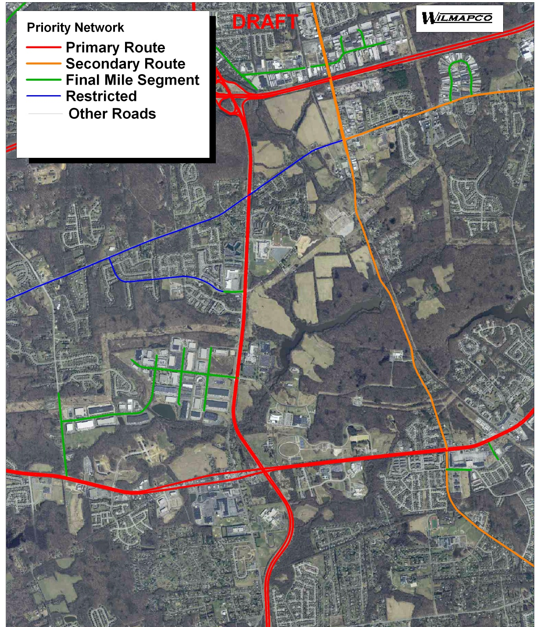
Fixing America’s Surface Transportation (FAST) Act
Freight Benefits
From Delmarva Freight Plan
Detail the peninsula’s freight network: Continue to define and refine a freight network for the Delmarva Peninsula, building on this plan, WILMAPCO’s classifications, and in coordination with DelDOT, MDOT, and VDOT. Further detail the network inventory by adding/mapping technical data such as road widths, bridge loads, weight limits, height restrictions, operating restrictions, etc., and by compiling all information into a readily-accessible format that can be referenced by or distributed to a broad audience.
Tier 1F – State Primary Freight Corridor
(included on the Federal PFN)
Tier 1S – State Primary Freight Corridor
(not included on the Federal PFN)
Tier 2 – State Secondary Freight Corridor
Tier 3 – First/Last Mile or other potential
freight-relevant connection
Tier 4 – not categorized

Slide 21
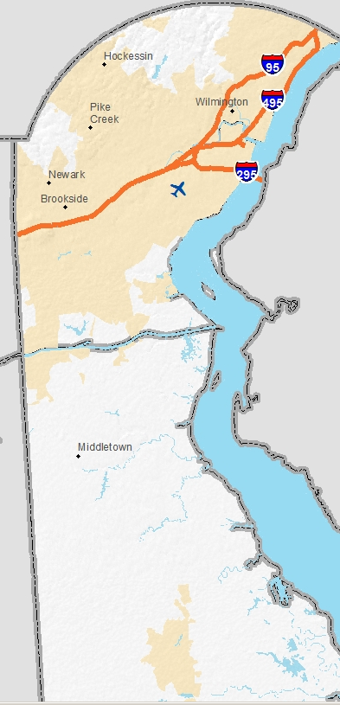
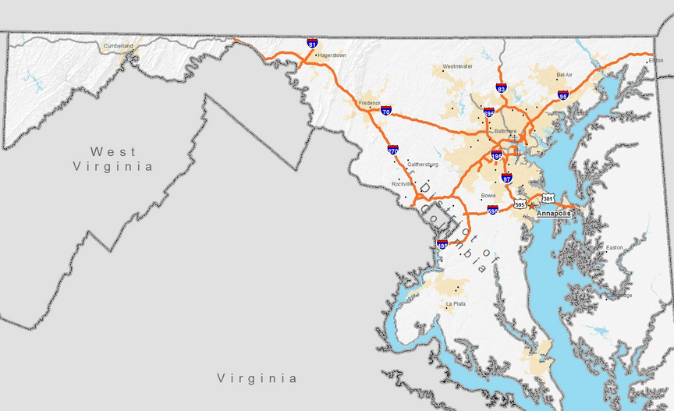
Fixing America’s Surface Transportation (FAST) Act
Freight Benefits

Slide 22
Fixing America’s Surface Transportation (FAST) Act
Freight Benefits
• States may use funding to improve freight mobility on the network; the Secretary shall calculate each State’s proportion of the primary highway freight system based on mileage in a State; if a State’s proportion is greater than or equal to 2% the State may obligate funds on the primary highway freight system, critical rural and urban corridors; in State with less than 2% of the miles the State may obligate funds for any component of the National Highway Freight Network
• States are required to develop a freight plan within 2 years or lose the ability to obligate funds
• Defines project eligibility and caps at 10% what a State can use on intermodal or rail projects
• Further defines uses of the funds such as development phase activities, preliminary engineering and design, other preconstruction activities, construction, ITS, reduction of environmental impacts and many other activities

Slide 23
Funding?????

Slide 24
Goal/ Visions
Planned for 2016

Slide 25
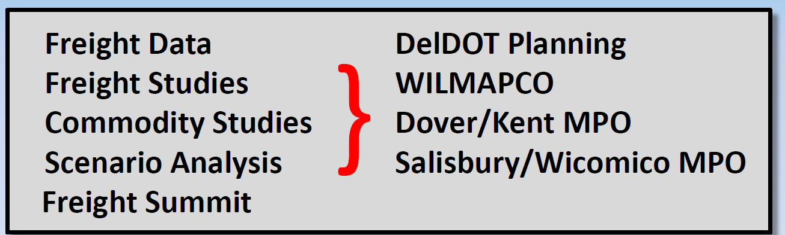
Freight Data:
Good Data NOT cheap!
Acquire FAF 4 When Available
Update IHS Transearch Data
(UPWP)

Slide 26
DelDOT/MPO Efforts – Planned for 2016
Delmarva Agricultural Supply Chain Analysis (Underway)
DE statewide truck data collection
- 62 temporary, 29 permanent locations
- Feed freight performance work
- help maintain freight model

Slide 27
Next Steps/Feedback Any other issues to be addressed?
Delmarva Goods Movement Priorities: Results from 2013 Summit Exercise
Made lots of progress
Which issues remain?
- Is the public sector moving the right direction?

Slide 28
Next Steps/Feedback Any other issues to be addressed?
Delmarva Goods Movement Priorities: Results from 2013 Summit Exercise

Slide 29
Next Steps/Feedback Any other issues to be addressed?
Delmarva Goods Movement Priorities: Results from 2013 Summit Exercise
Freight Plan
Detailed Crash Analysis?
Project Prioritization
Supply Chain Analysis
Port Truck Study
Freight Plan
Freight Plan Adoption
Supply Chain Analysis

Slide 30
Other items?

